Slide 1

Sustainability Support for Education
Notes:
Hello and welcome to the Sustainability Support for Education Action for Climate session.
Couple of minutes
Thank you for joining us. Today we’re going to be taking you through the DfE funded sustainability support for education Hub.

Slide 2




Housekeeping
Please keep yourself on mute
Feel free to introduce yourself in the chat
Feel free to have your camera on or off
Put questions in the chat at any time
Notes:
Introduce Tim (Department for Education lead) or Gayle (Head of Sustainability Support) who’s going to talk a little bit about the context of the Sustainability Support for Education Hub and the wider Department for Education strategy.
after housekeeping

Slide 3
Today you will…
Be introduced to Sustainability Support for Education and have a demo the site
Been taken through sign up and create an account
Identify an aim or aims to work on that are right for your setting
Consider which colleagues you want to work with you on sustainability
Find out how to save those aims and share them with colleagues
Information on associated support available
Notes:
The purpose of the session is to show you how the Hub works and to give you the time to sign up and create an account, find aims and actions that you want to take, and to create a list that you can share with others in your setting to begin conversations on how your going to take climate action.
We’ll also give you information on accessing another of the DfE’s funded projects - the Climate Ambassadors.

Slide 4
Climate Action
Reduce emissions - energy bills
Drive behavioural change and shifting mindsets - waste
Developing resilience to the effects of an ever changing climate - heat
Increasing access to, and connection with nature - making the most of the space available
Notes:
First, just to understand what is meant by climate action. This covers a whole range of activity for example it can be thinking about how to reduce your school's carbon footprint or emissions. So that can be related to things like energy, or food, or procurement or travel.
Climate action also involves thinking about how to create shifts in mindsets and behaviours to help your staff and learns act more sustainably.
It also touches on improving the resilience of your estate and operations by adapting to the changing climate and more extreme weather events that we are starting to see.
It also includes thinking about our relationship with nature around us and how we can improve biodiversity, but also the added benefits that nature can bring for our mental health and wellbeing.
And finally also thinking about how we need to prepare our learners and young people for climate change and its impacts through education and skills.

Slide 5
Climate Action Plans
We all need to take action towards a more sustainable future.
It's a tool to create focus for your activity and to bring your colleagues with you.
Help you create a vision to drive ambition and realise your goals
Evidence shows that taking climate action will have lots of wider benefits for your setting such as:
financial savings from energy efficiency;
mental health and wellbeing through outdoor learning;
improving the school infrastructure and estate.
A whole-institution approach to sustainability can effectively demonstrate compliance with various aspects of the Education inspection Framework.
Notes:
So your Climate Action Plan is essentially going to be the tool that will help you to engage with your staff and learners and wider community, and allow you to prioritise your activity and efforts. And the wonderful thing about climate action is that it often comes with additional benefits, so that might be financial savings or improving wellbeing, and even improving the school estate. GO INTO DEMO TO LOOK AROUND SITE

Slide 6
A free online service
A place for all educational settings to build their Climate Action Plans and do it:
Quickly: easy to navigate for time poor staff.
Easily: One stop shop, covering all 5 pillars
Well: the highest quality resources, checked by experts.
Notes:
SHOW THEM THE SITE AND TAKE A LOOK AROUND
Include the links to starter packs

Slide 7
Benefits of Registering
Save actions and related resources to come back to later
Download actions to add to your Climate Action Plan
Share actions and resources that you've found with colleagues and collaborators
Input details on your setting to get more tailored suggestions
Notes:
So for the first activity in today’s session, we’re going to give you some time to register. And by registering you’re going to be able to save actions and resources to come back to later, you’ll also be able to download actions to use in your Climate Action Plan. You’ll also be able to share the action and resources you find with your colleagues. So for example, if you want to speak to your catering team about how to reduce food waste, you can share any resources that will help them to do that directly with them.

Slide 8
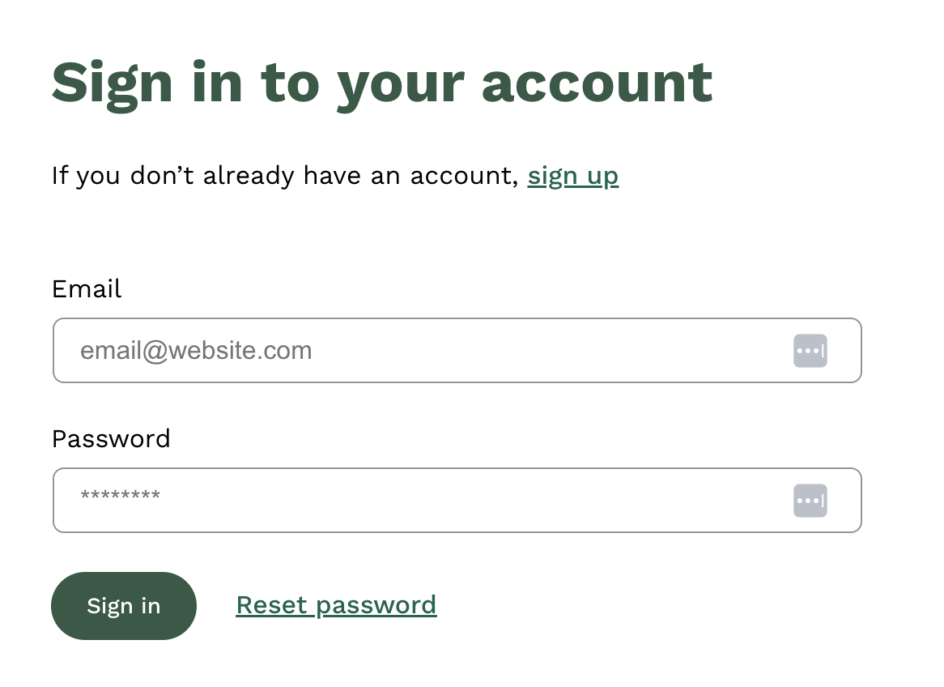
Login process
Note, you will need to verify your account
Notes:
So the first step to sign up is to click on the sign up button, and you’ll need to enter your email address. And then click on the verification link that is sent to your email address.

Slide 9
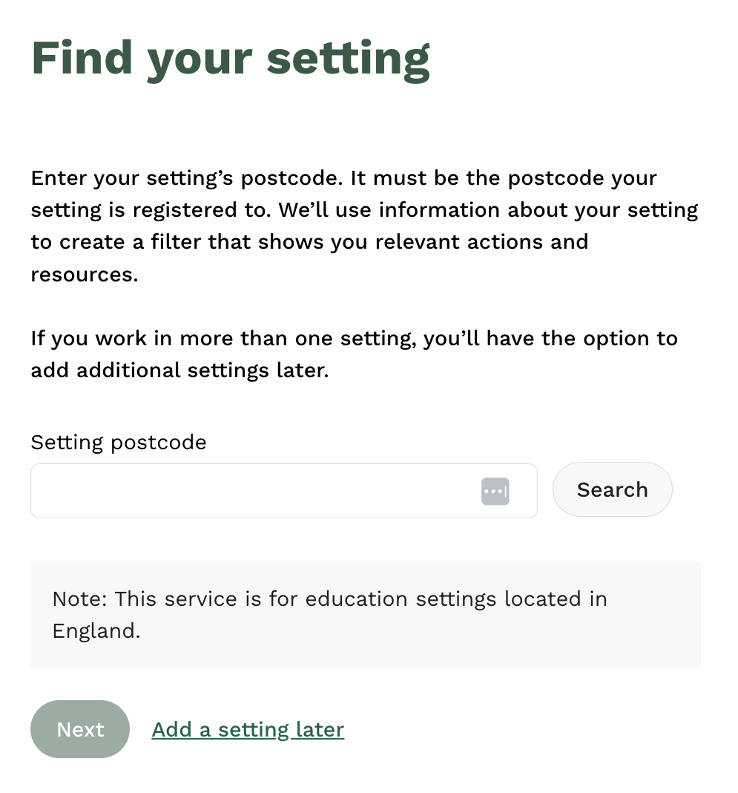
Add details on setting
Notes:
Once you’ve done that you will then be prompted to provide your setting’s postcode, and this will create a profile for that setting on your account, so that you can pre-set your filters to make the actions and resources more relevant to you.

Slide 10
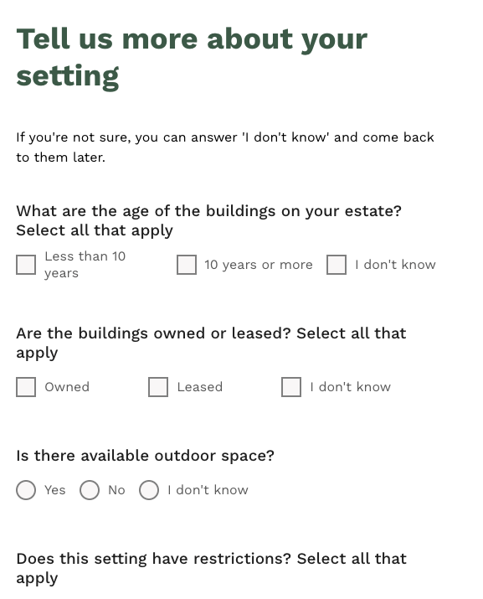
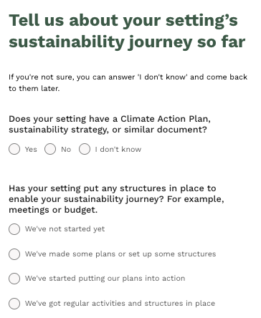
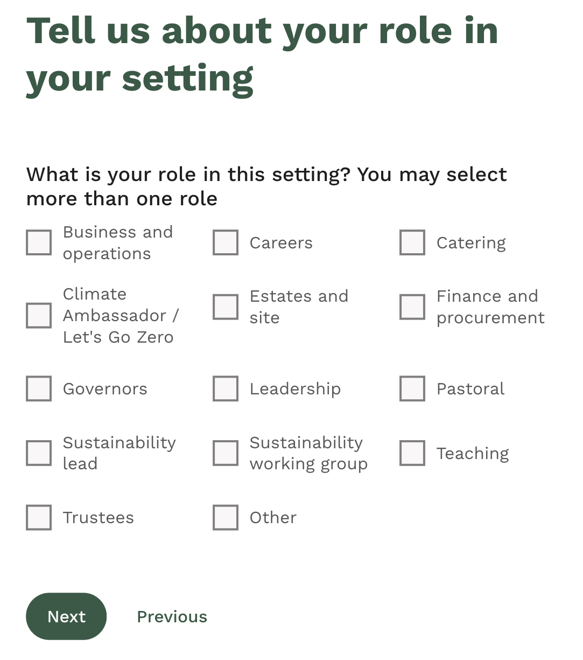
Add details on setting
Notes:
And then there are a couple of questions that will allow you to pre-set your filters, if you don’t know the answer to them you can just select I don’t know, and come back later to update them if and when you’re ready.

Slide 11
Register on the service
Notes:
Ok so now we will give you 5 minutes to register yourselves on the service following those steps. Amy if I can ask you to set a timer for us.

Slide 12
Foundations of the Site
Department for Education Strategy Pillars
Sustainability Fundamentals
Decarbonisation and Energy Efficiency
Climate Adaptation and Resilience
Biodiversity and Green Infrastructure
Climate Education, Green Skills and Careers
1
Setting the groundwork
2
Taking the first steps
3
Sustainability Support for Education
Maturity Stages
Developing your practice
4
Learning to Lead
5
Advanced actions
Notes:
NEXT PRESENTER
The site has been built to guide all settings, whether from early years all the way through to higher education, on what best practice looks like when taking climate action. And to help you become more familiar with using the site,its helpful to understand the journey that you will go through as you use it over time. So the site guides you through different stages of maturity, starting at level 1 which will help you to create the foundations you need to get started, which includes things like creating a sustainability working group and understand what you’re already doing on climate action, and it will help you to identify your priorities, and engage your staff so that you can start to create your climate action plan. And then from there you will be able to progress through the later stages of maturity, that sit across the Department for Education’s four strategy pillars, which are:
And so its been built to be something that you can dip into again and again over time, for inspiration on actions to include in your plan and to work towards, and to find the resources that will help you complete those actions.

Slide 13
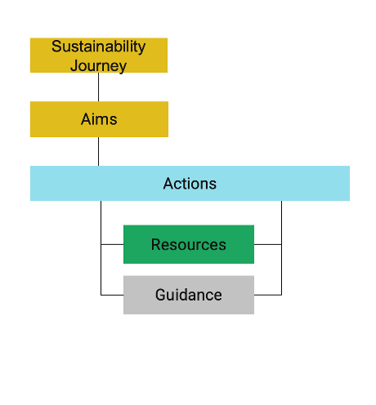
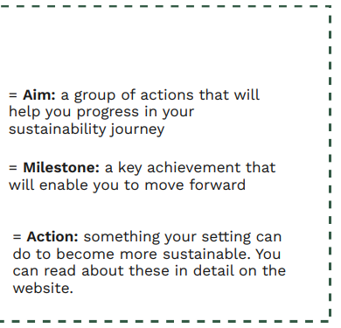
Your building blocks: Aims and Actions
Resources of the highest quality. See QA here.
Notes:
And so this sustainability journey that you will go on, this has been developed by sustainability experts in conjunction with the United Learning Trust. And the journey is built up of different aims. And these aims are groups of actions arranged in a step by step sequence to help you progress on your sustainability journey in an easy, logical way. And the actions are then supported by resources and guidance that will help you to complete those actions. So hopefully you can see that hierarchy through the visual on screen. But to bring it to life I’m going to do a quick demo… on how to explore aims and actions and save them to a list.

Slide 14


Slide 15
Tips for choosing appropriate aims or actions
Consider what progress has already been made
Your unique context and site restrictions
Be ambitious but realistic
Be guided by the sequenced steps on the site
Ask for help when needed

Slide 16
Your phase and your setting
Early Years: Focus on outdoor learning and improving wellbeing and connection to nature.
Promote the benefits of using outdoor learning spaces to your stakeholders
Introduce outdoor activities as part of learning
First 10 actions for an EY setting HERE.
Primaries: Focus on building the groundwork.
Assess the current sustainability position of your setting
Understand what data is available across all areas of sustainability
Consult your community on creating sustainability aspirations
Identify your sustainability priorities
Agree a sustainability vision
Start to build a whole-setting awareness of sustainability
View Primaries Suggestions List HERE.
Secondaries: Focus on taking the first steps.
Create a sustainability working group
Appoint a sustainability focussed governor
Understand your energy use
Understand how people travel to your setting
Conduct a waste audit.
View Secondaries Suggestions List HERE.

Slide 17
Identify an aim for your setting & Save to list
Notes:
So now we are going to give you some time to identify an aim that you think your setting could work towards and save it to a list, following the steps we just went through in the demo. And we’ll give you 5 minutes for this I think.
We’d love to hear which aim you’ve chosen if you’d like to post in the chat

Slide 18
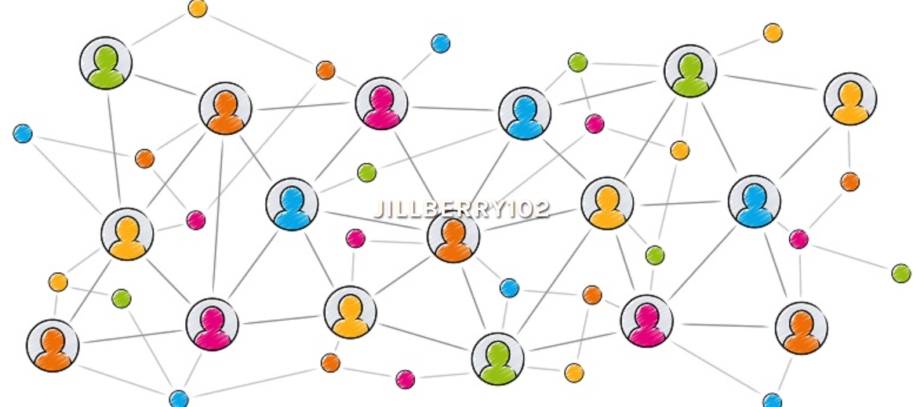

A whole setting approach
Use your networks to drive change
Why?
To share the workload
To share the responsibility
To help embed into daily operations, culture and ethos
To ensure people feel included
Notes:
Now that you have identified some actions you want to focus on, its worth mentioning the importance of a whole setting approach, because sustainability isn't just about one-off activities, it needs to be embedded in every aspect of a your daily operations, culture, and care and learning and play. And this is particularly important because climate action shouldn’t just be left to one person, its a group effort, and its much more manageable and achievable when we share the load.

Slide 19
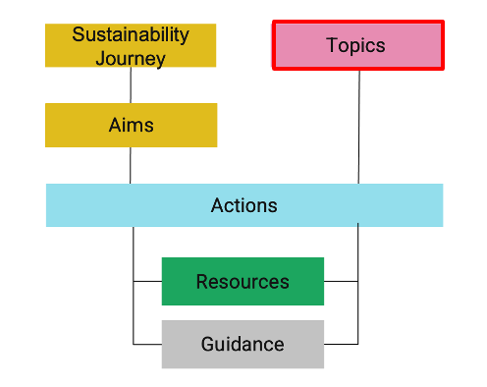
Using Topics
Topics are a useful and quick way to collaborate with colleagues and for them to quickly navigate to appropriate actions, resources guidance & support.
For example, site teams maybe interested in reducing energy costs and therefore go straight to the Energy Topic.
Business/finance managers maybe interested in Funding or Procurement.
Governors in Planning and Monitoring
Kitchen/catering staff in Food & Catering and Waste
Notes:
And then just to touch on the other way that you can use the site, you’re also able to look for actions and resources by topic, so quick demo on what that looks like

Slide 21
Creating your plan
Ask yourself:
WHAT are your chosen actions?
HOW are the actions going to be done? Use the resources to do this.
WHO is going to be responsible and deliver the action?
Be sure to share your plan with your setting and community.
WHEN are things going to get done? Have a progress measure to help with this (not started, on track, delayed, completed)
Nice to have:
Costs
Links to School Improvement Plan (if applicable)
Actions to provide more support:
Develop a short term action plan
Develop a long term action plan

Slide 22
Identify three people to engage
Notes:
So now you have your list, which is fantastic, we’d like you to think about three people that you want to engage in your setting to help you start making progress towards your aim, again thinking about that whole setting approach. Post in chat.

Slide 23




In Summary
For online support to:
- Identify sets to take for your action plan
- Access resources to help you take action
For in person, expert support to help develop and implement your plan
For curriculum linked resources and hands-on activities that empower students to transform your grounds
Notes:
NEXT PRESENTER
Now you have your aims and you can start to share them with your colleagues and begin those conversations which is fantastic. What we also want to do is highlight other organisations that can help you to make progress on your climate action journey. So the first of those is an organisation called Let’s Go Zero and they offer in person support to help you develop your climate action plan. Similarly there is also the climate ambassadors scheme which we will show you how to register your interest with today, and they can also provide in person expertise to help you complete the aims you’ve identified today. Finally there is also the National Education Nature Park and they offer an online process that will help your school to improve their nature and biodiversity, in conjunction with learning.

Slide 24
Requesting a Climate Ambassador
Notes:
So focusing on the climate ambassadors now

Slide 25

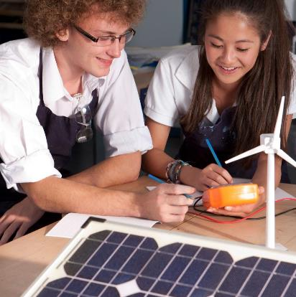
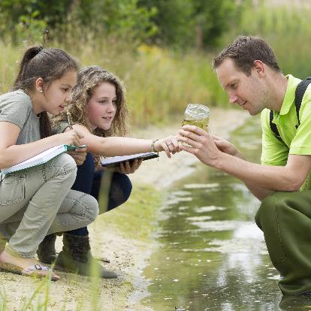

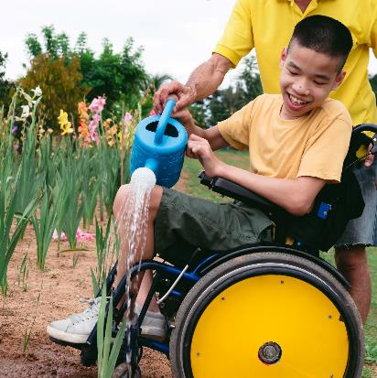

Our objective
To provide education settings within England access to support from volunteer Climate Ambassadors, who will help them develop and deliver impactful Climate Action Plans.
Adaptation and resilience
Decarbonisation
Climate education and green careers
Biodiversity
Notes:
The Climate Ambassador scheme provides education settings with free access to a diverse network of trained volunteers from across relevant private, public, charity and education sectors to provide tailored guidance and support to progress their Climate Action Plans. The ambition is to support settings, wherever they are on their journey, to:
1. Decarbonise by becoming more efficient across their operations, to save money and reducing emissions.
2. Adapt and build resilience against the risks of climate change, such as overheating or flooding.
3. Increase biodiversity across the estate and improving access to green space.
4. Weave climate education and green careers across teaching and student facing activities.
By education settings we mean all nurseries, pre-schools, primary and secondary schools, multi academy trusts and colleges. This work is funded by the Department for Education and delivered by the University of Reading and EAUC. It directly supports the delivery of the department’s climate change and sustainability strategy.

Slide 26

What is a Climate Ambassador?
Volunteers from across private, public, charity, university and community sectors who want to put their climate change and sustainability knowledge to work.
Aim to support education settings deliver meaningful change on sustainability and climate change.
Climate Ambassadors will be fully DBS checked, have undertaken mandatory training and have access to a suite of additional training to complement their existing expertise and skillsets.
Work with leaders, staff, young people and governors.
Notes:
Its important to note that the ambassadors are fully DBS checked and have undertaken mandatory training to provide you with the support you will receive.

Slide 27
What can Climate Ambassadors offer education settings?
Get started creating and progressing your climate action plan
Inspire action in your setting
Identify ways to decarbonise your operations
Plan and adapt to the impacts of climate change, to minimise risk of disruption to learning
Increase biodiversity across your setting’s estate and improve access to green space
Provide advice on how you can weave climate education and green careers inspiration across teaching and learning activities
Upskill you staff to build their confidence in teaching about climate and sustainability
Notes:
Get started creating and progressing your climate action plan, providing you with the help to inspire action in your setting and the advice to initiate your plan.
Identify ways to decarbonise your operations- saving money and reducing harmful emissions that contribute to climate change.
Plan and adapt to the impacts of climate change, like overheating or flooding, to minimise risk of disruption to learning.
Increase biodiversity across your setting’s estate and improve access to green space for your learners and staff.
Provide advice on how you can weave climate education and green careers inspiration across teaching and learning activities and upskill you staff to build their confidence in teaching about climate and sustainability.
Example activities:
Introducing Climate Action Plans and DfE requirements to Senior Leadership Teams and Governors
CPD sessions for staff
Helping educators develop sustainability and climate skills within the curriculum
Inspiring young people through careers talks
Assisting with specific actions in your climate action plan

Slide 28

Regional support
East Anglia (University of East Anglia) - climateambassadors_ea@uea.ac.uk
East Midlands (University of Nottingham) -ca-eastmids@nottingham.ac.uk
London (University College London) - climateambassadors_london@ucl.ac.uk
North East (Newcastle University) - climateambassadors.ne@newcastle.ac.uk
North West (Manchester Metropolitan University) - climateambassadors_nw@mmu.ac.uk
South East (University of Reading) - climateambassadors_se@reading.ac.uk
South West (Met Office) - climateambassadors_sw@metoffice.gov.uk
West Midlands (Keele University) - climate-ambassadors.wm@keele.ac.uk
Yorkshire & Humber (University of Leeds) - climateambassadors_yh@leeds.ac.uk
https://climateambassadors.org.uk/get-involved/
Notes:
So if you would like that additional in person 1 2 1 support then you can reach out to your regional hub and they will help you to get started.

Slide 29
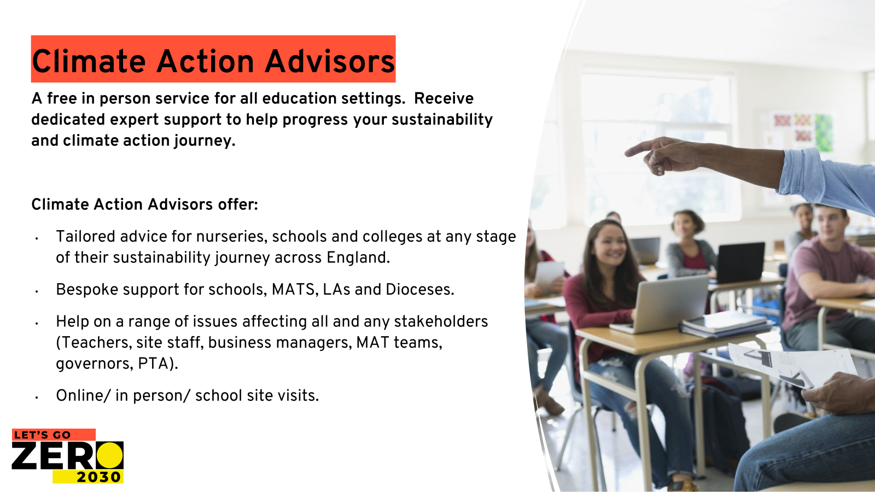
Sign up here

Slide 30
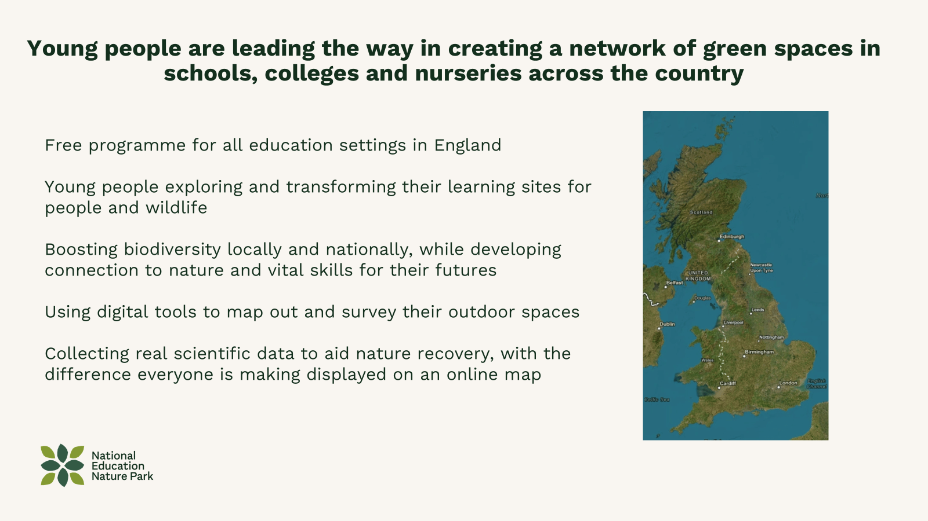


Slide 31
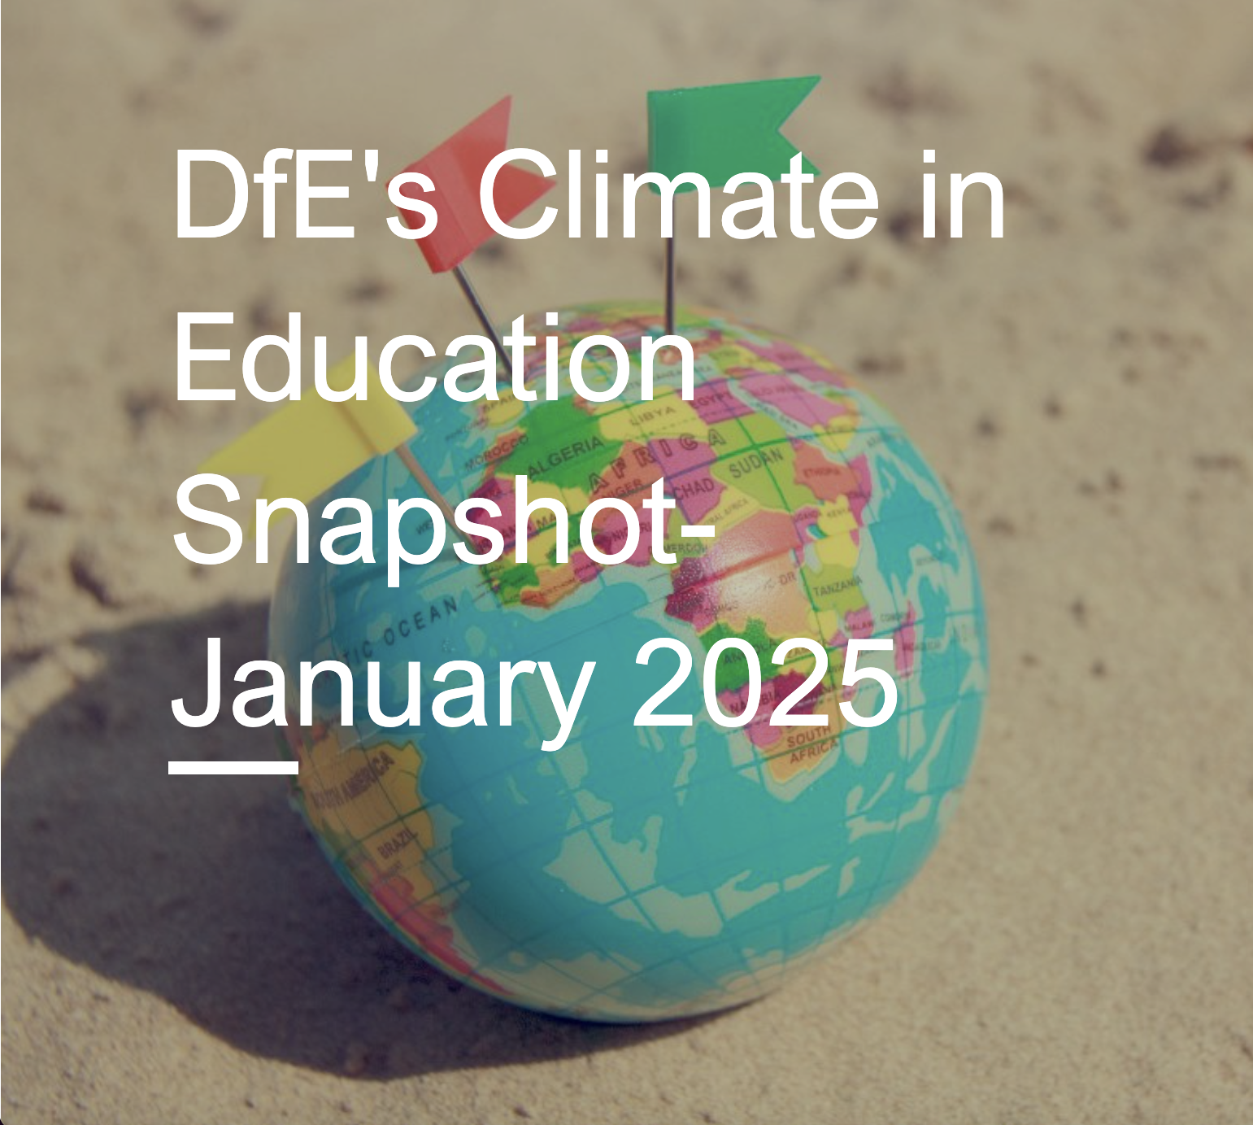
DfE snapshot
Receive news and updates from the Department for Education about sustainability related topics. Sign up here
Notes:
And finally before we move onto questions, you can also sign up to the DfE’s snapshot to stay updated on sustainability related topics and news.

Slide 32
Questions

Slide 33
Further Events
We are running more of these events in the future, click here for more details.
Please connect on LinkedIn for the latest updates and events.
Notes:
Include the links to starter packs

